Slide 1
Walter Pham Portfolio Slides
Junior Web Dev

Slide 2
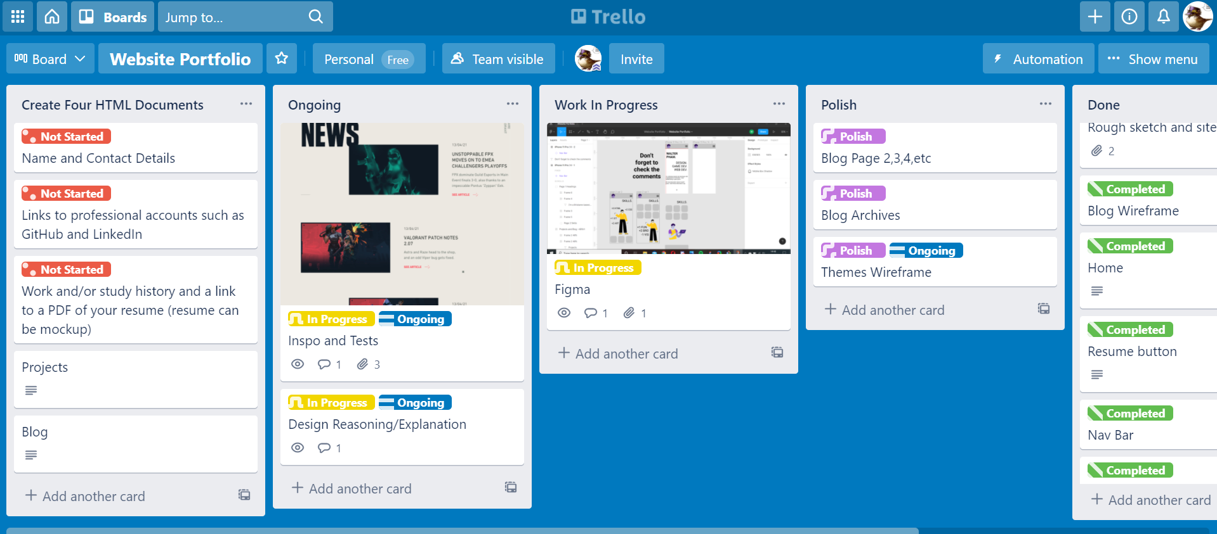
A LIST OF COMPONENTS
HTML | CSS | SASS languages | 1 line of Javascript
VSCode and Git Bash
Fontawesome icons | Google Font
GIT for Version Control
Trello for Project management
Figma for wireframes
Navbar
Notes:
I just knew I needed JavaScript to do cool stuff, but was limited because I haven’t learnt it yet.

Slide 3
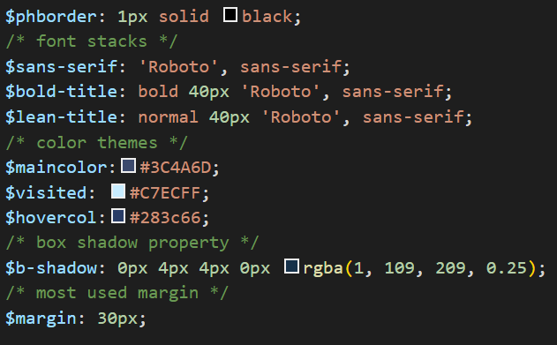
A LIST OF COMPONENTS
Placeholder border to check container grids
Commonly used fonts
Commonly used colours
Shadow property
Commonly used margin
Notes:
I just knew I needed JavaScript to do cool stuff, but was limited because I haven’t learnt it yet.

Slide 4
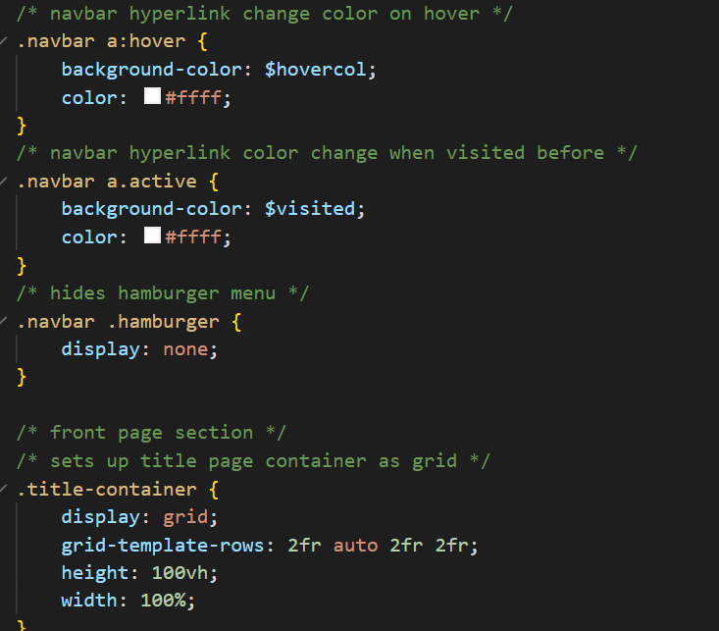
A LIST OF COMPONENTS
Change color of navbar link on hover
Active navbar link color
Hides hamburger menu
Title page container
Notes:
I just knew I needed JavaScript to do cool stuff, but was limited because I haven’t learnt it yet.

Slide 5
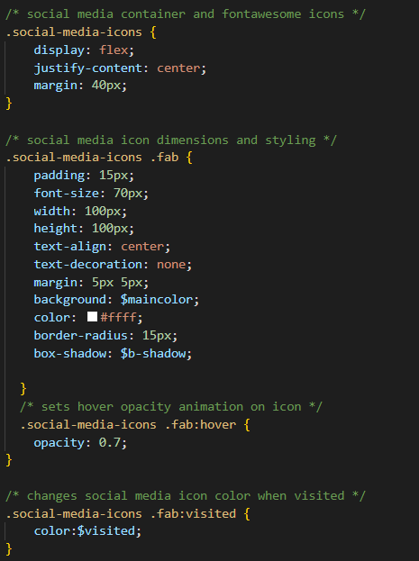
A LIST OF COMPONENTS
Social media icon container
Social media icon styling
Social media icon animation on hover
Social media icon color change when visited before
Notes:
I just knew I needed JavaScript to do cool stuff, but was limited because I haven’t learnt it yet.

Slide 6
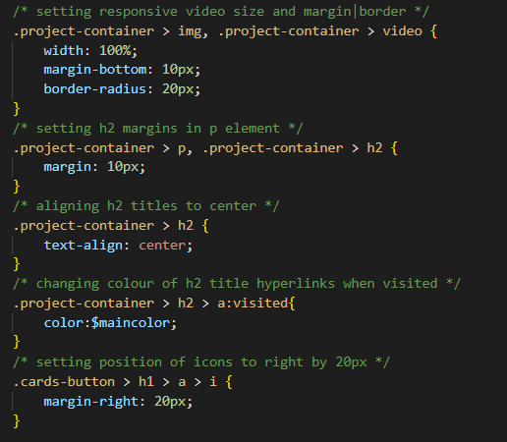
A LIST OF COMPONENTS
Projects container with video dimensions
Margin on headings in projects container
Align text in project container
Change visited hyperlink color
Margin of 20px to project cards
Notes:
I just knew I needed JavaScript to do cool stuff, but was limited because I haven’t learnt it yet.

Slide 7
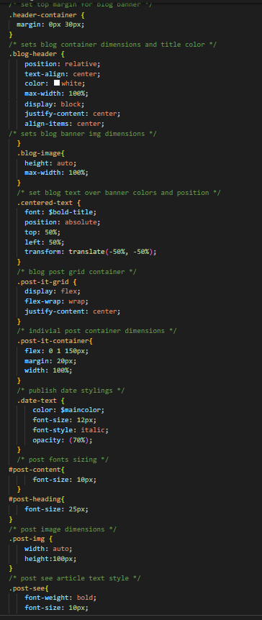
A LIST OF COMPONENTS
Blog banner container dimensions
Blog banner dimensions
Blog post grid container dimensions
Blog post fonts
Blog post image
Blog image dimensions
See more text style
Notes:
I just knew I needed JavaScript to do cool stuff, but was limited because I haven’t learnt it yet.

Slide 8
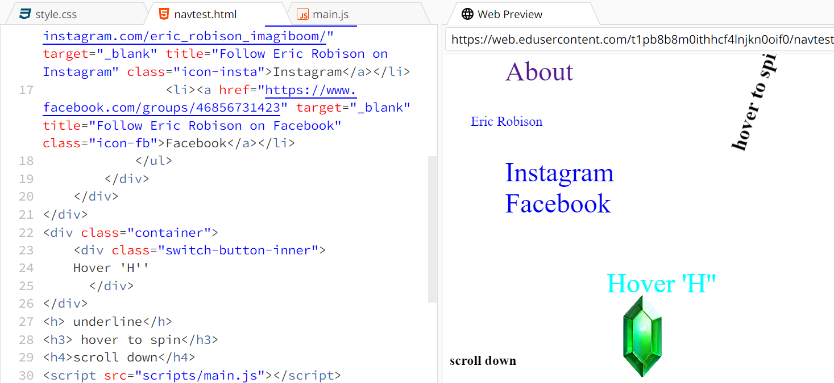
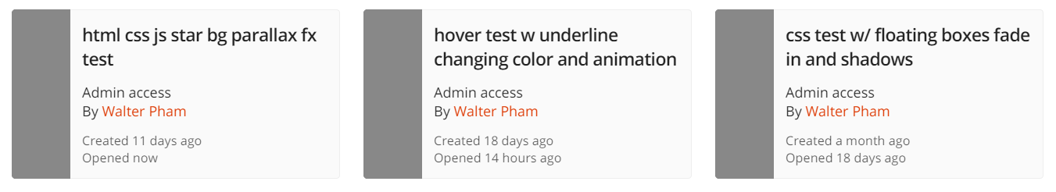
IN THE BEGINNING...
Before the brief
Lot of BIG ideas with no idea how (sort of)
Know that Javascript was required for complex interactions
Lot of testing while learning | Ed/w3schools
Inspecting interesting websites

Slide 9
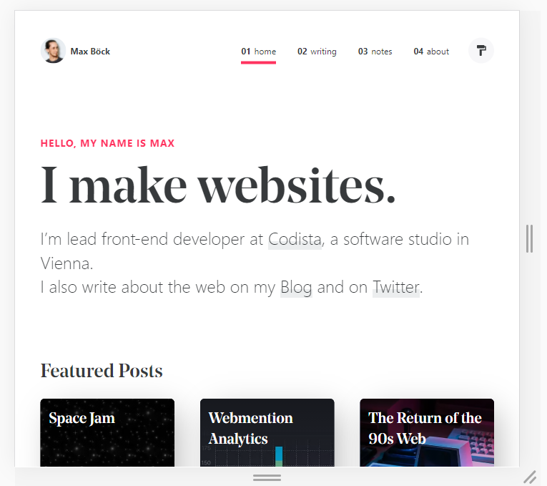
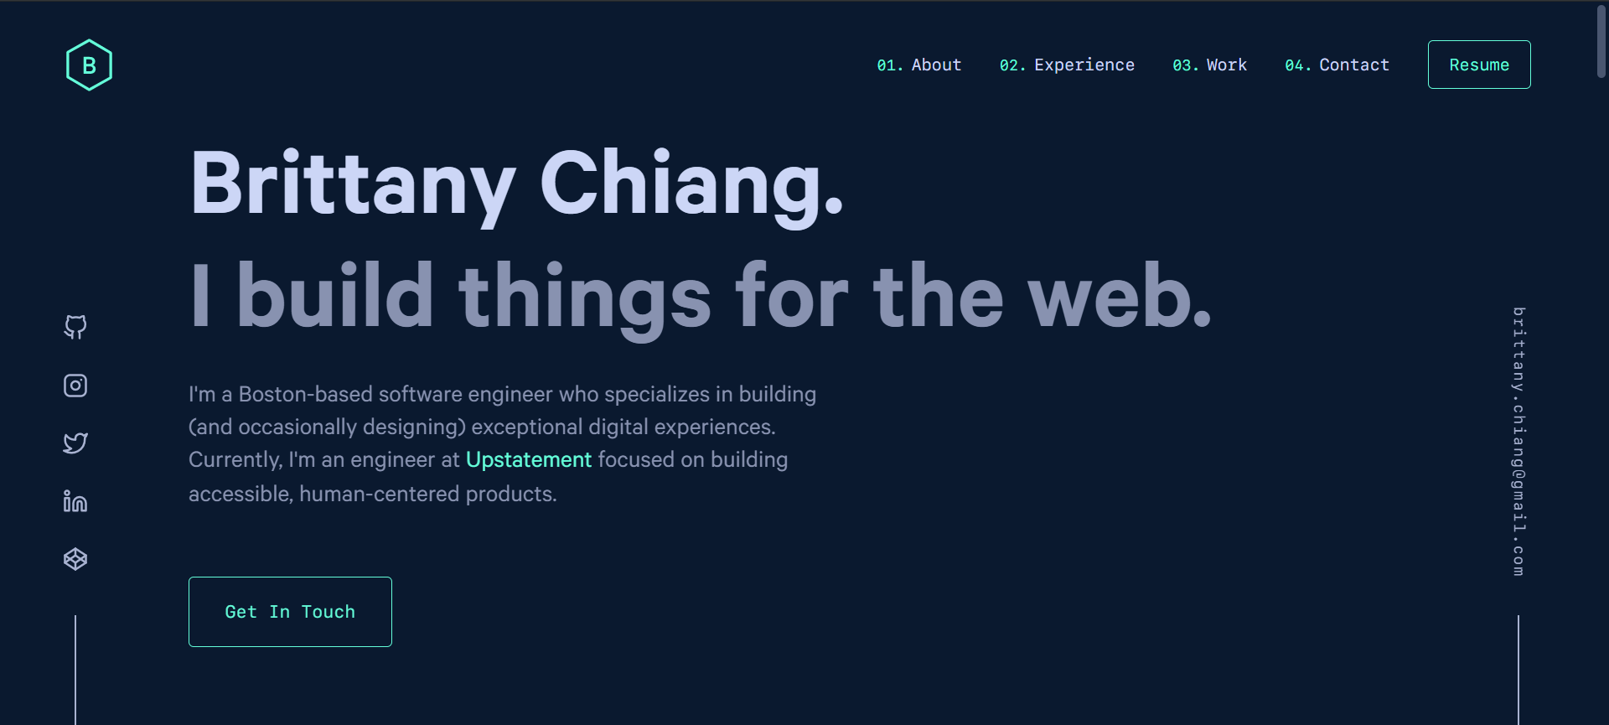
THE BRIEF.
Build around the necessities for scope (keeping scope small)
Looked at other webdev portfolios and found inspo
Awwwards.com
Notes:
I just knew I needed JavaScript to do cool stuff, but was limited because I haven’t learnt it yet.

Slide 10
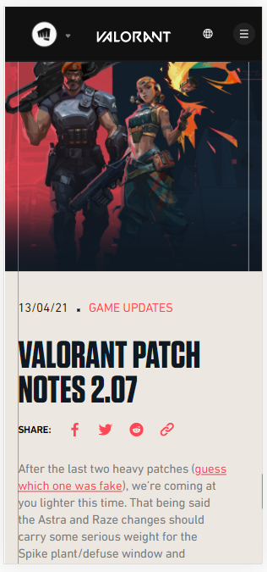
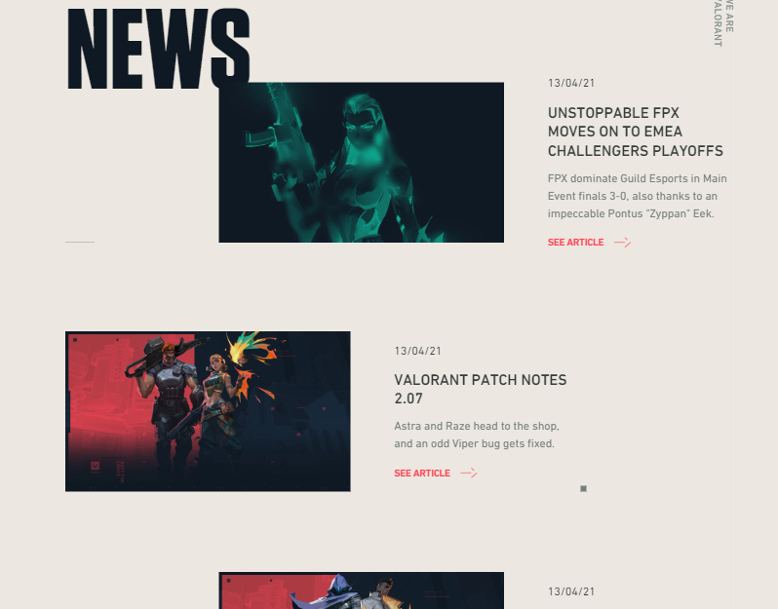
DIRECTION.
Simple//Bold//Clear designs
Felt Achievable
Few colours/Minimalistic
Notes:
From the inspo I kinda knew which direction to go

Slide 11

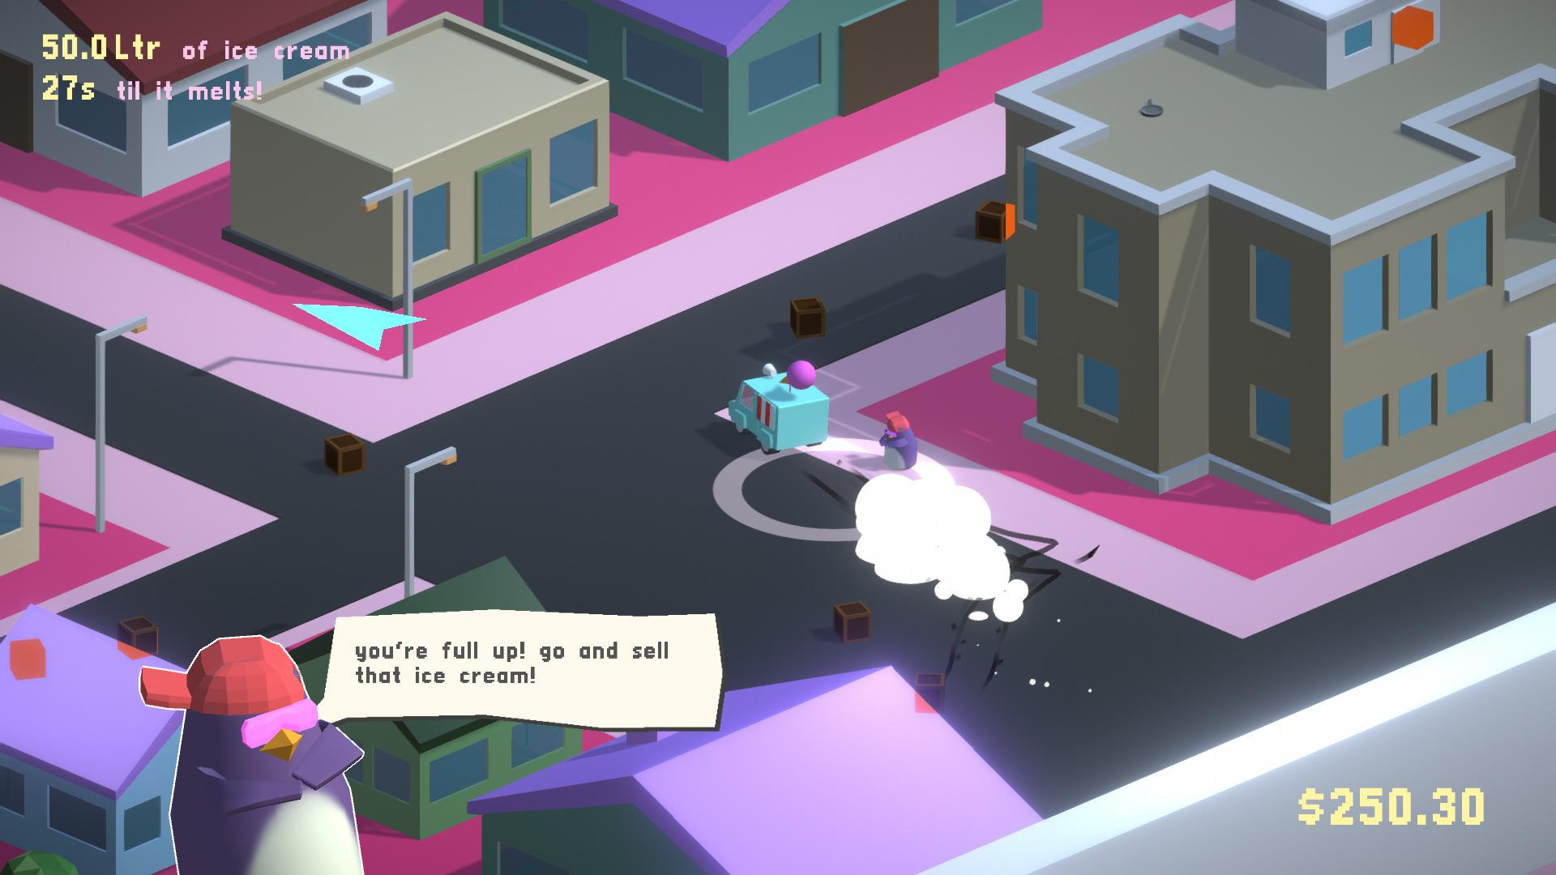

ARTIST? GAMEDEV?
Assessment asks for Dev or IT Professional
Blend skills and more personal
Include artwork and Game Dev
Notes:
From the inspo I kinda knew which direction to go

Slide 12
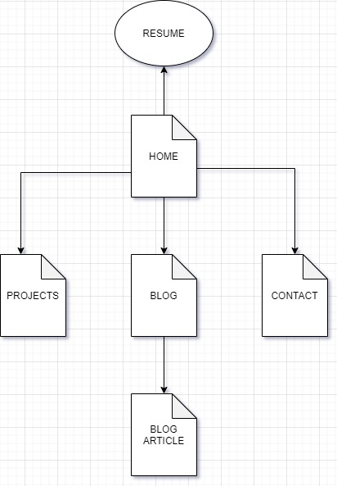
SITEMAP
Home - Short Intro | Interests/Skills
Projects - Variety/Collaboration/Create
Blog | Blog Article
Contact Form
Resume Button opens into PDF
Navbar/Hamburger 🍔
Notes:
From the inspo I kinda knew which direction to go

Slide 13

WIREFRAME VIDEO
Helped a lot to get it down
Less Ambiguity
Know what I’m working on next
Figma was really good
Super easy mobile to desktop

Slide 14
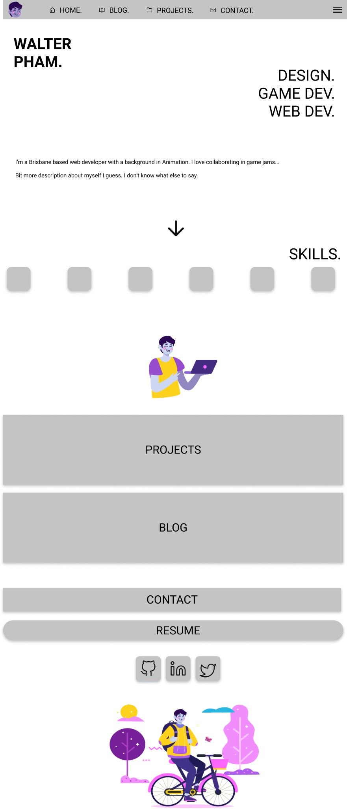
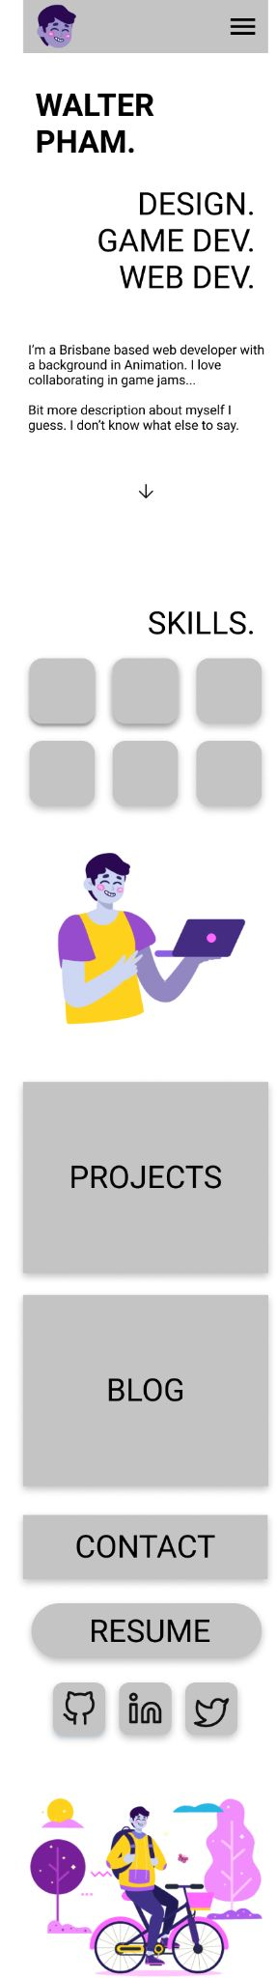
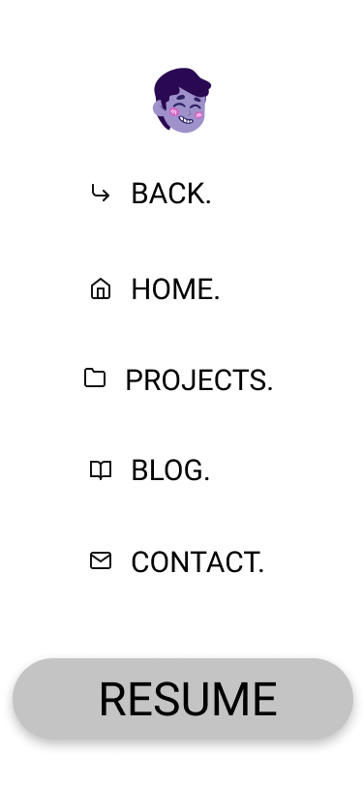

HOME
& NAV BARS
& SOCIAL MEDIA
WIREFRAME

Slide 15
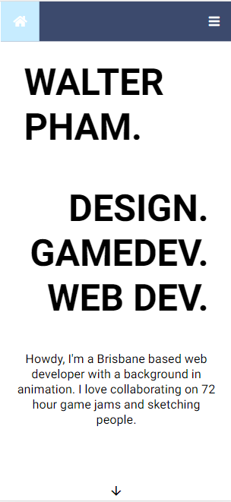
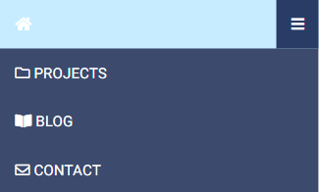
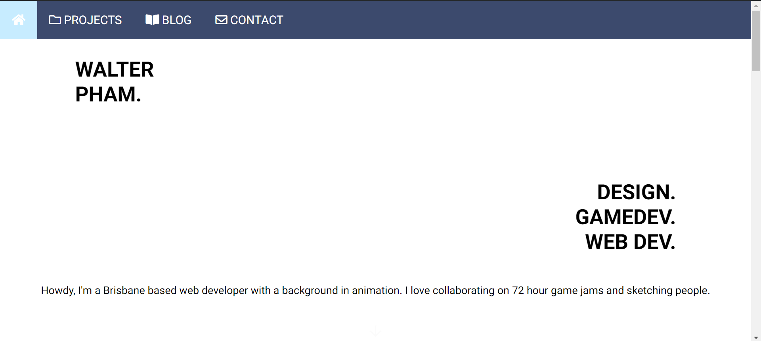
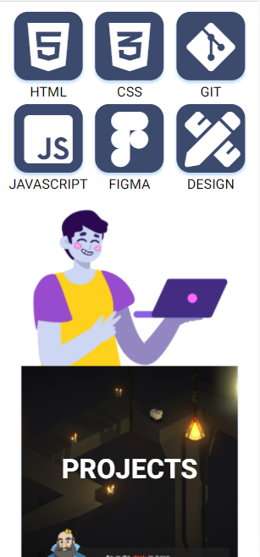
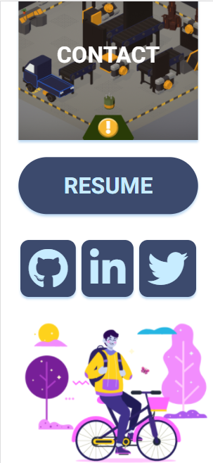
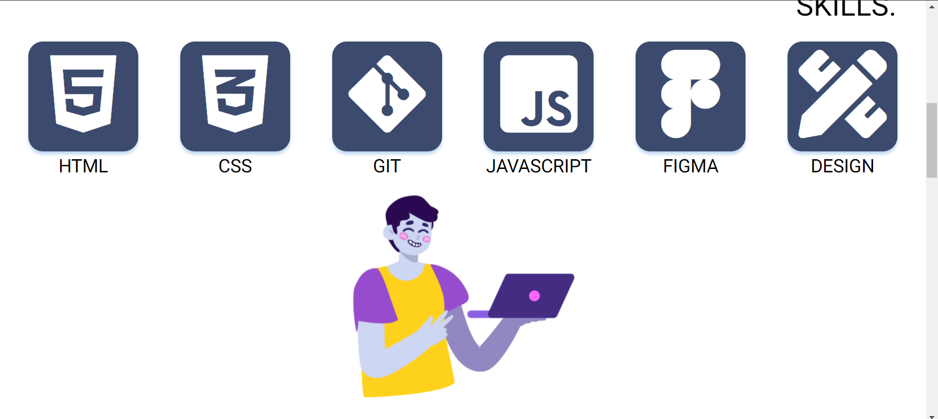
HOME &
NAV BARS WEB

Slide 16
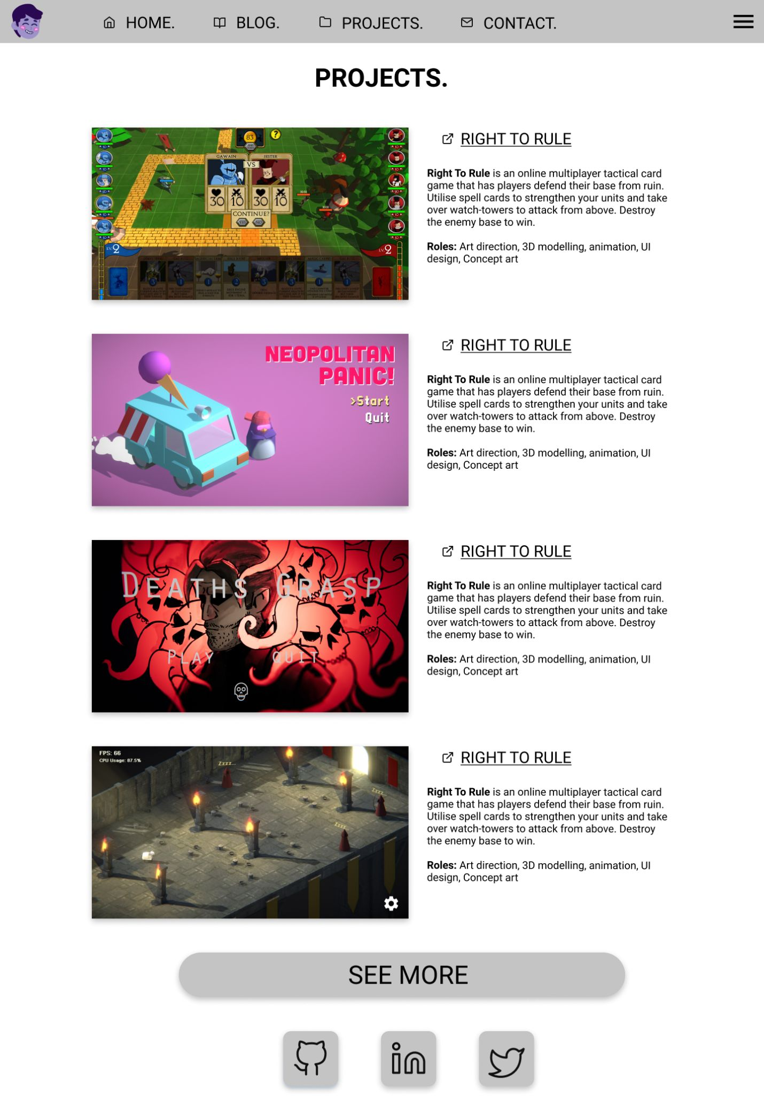
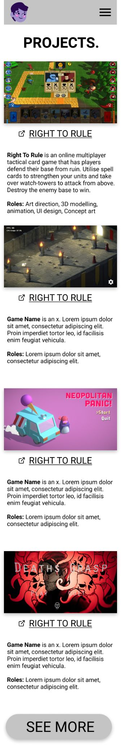
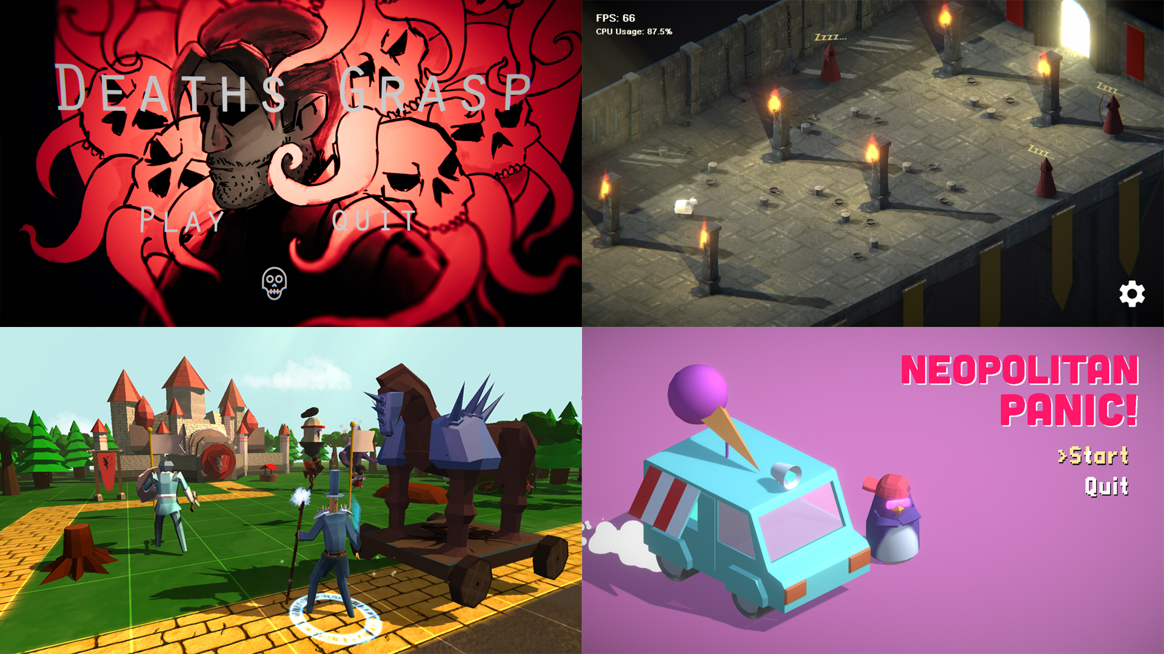
PROJECTS WIREFRAME
“Thumbnail” videos for engagement
Large scale/up in yo’ face

Slide 17
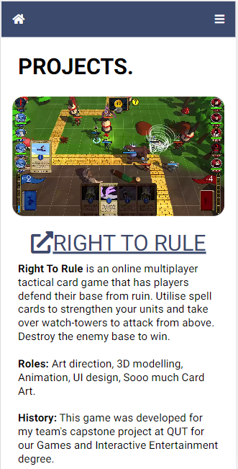
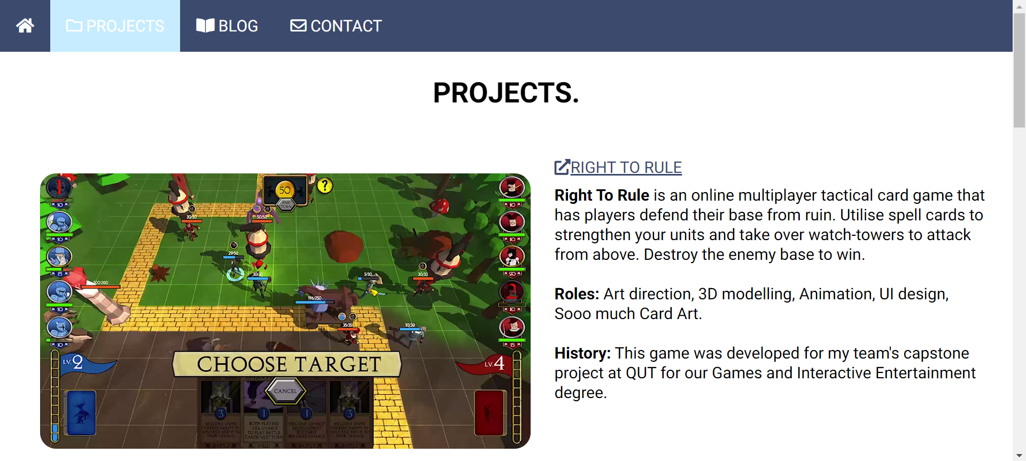
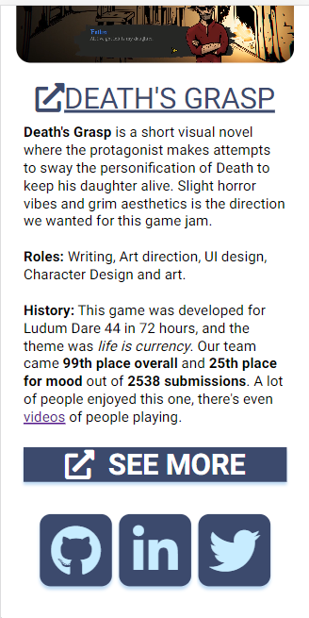
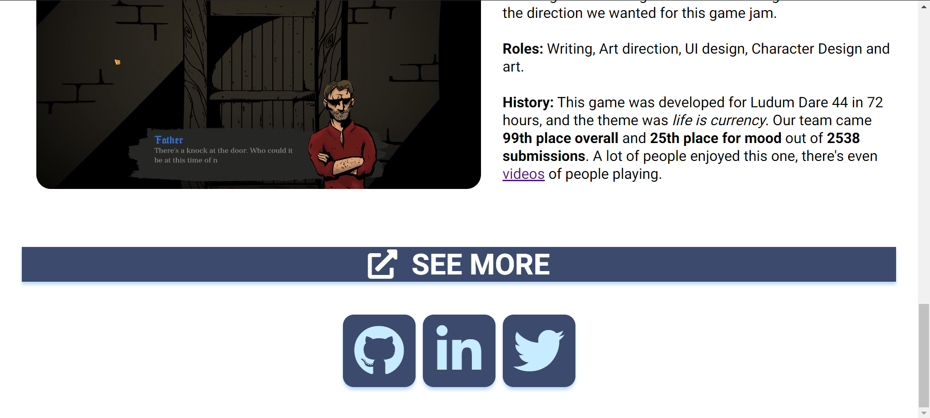
PROJECTS WEB

Slide 18
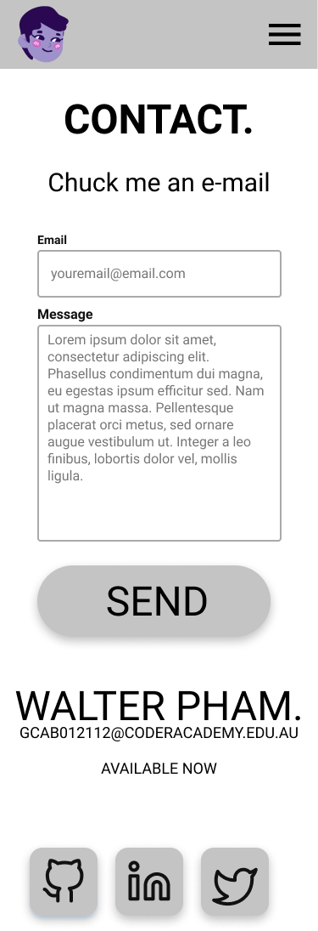
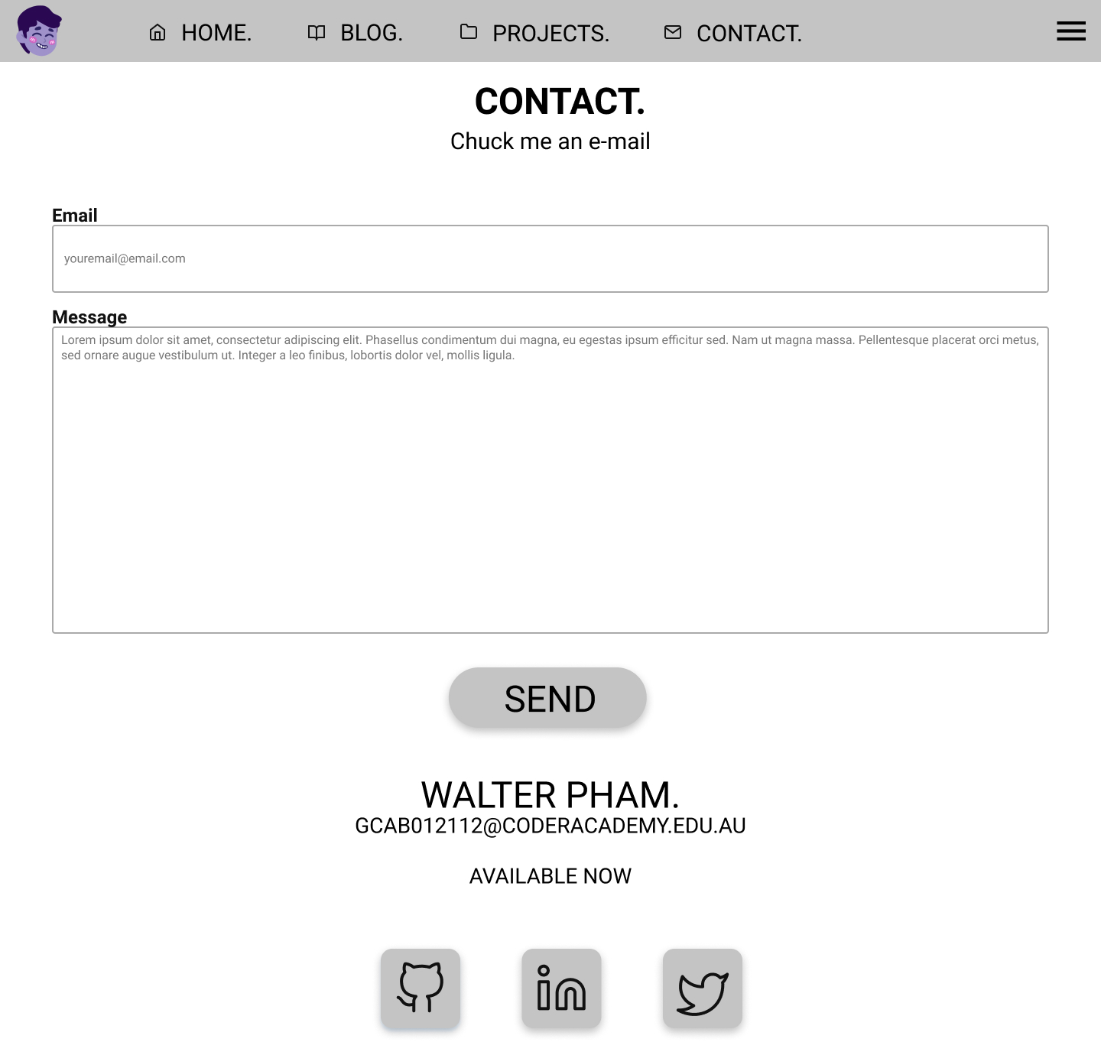
CONTACT
WIREFRAME
Form
Easier than opening
E-mail apps
Formspree.io

Slide 19
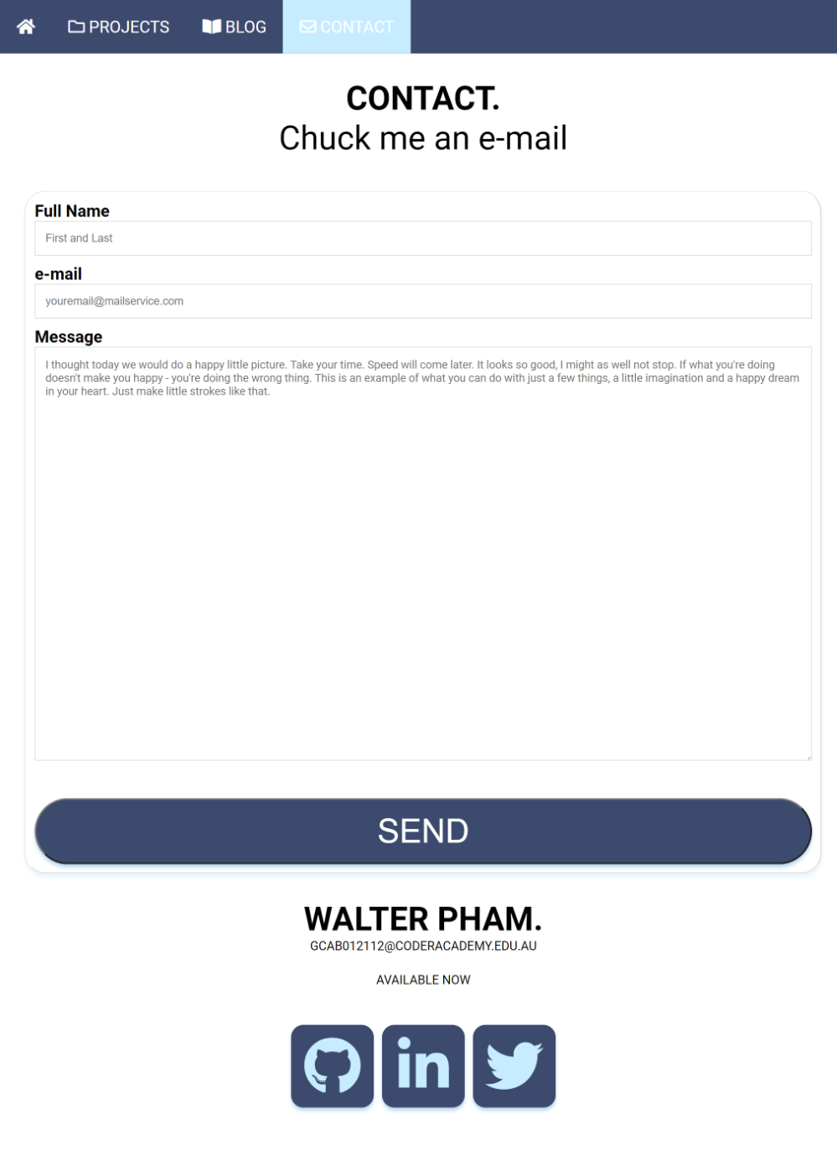
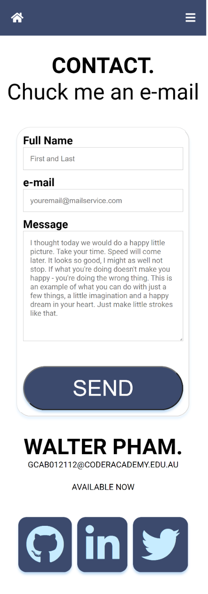
CONTACT WEB

Slide 20
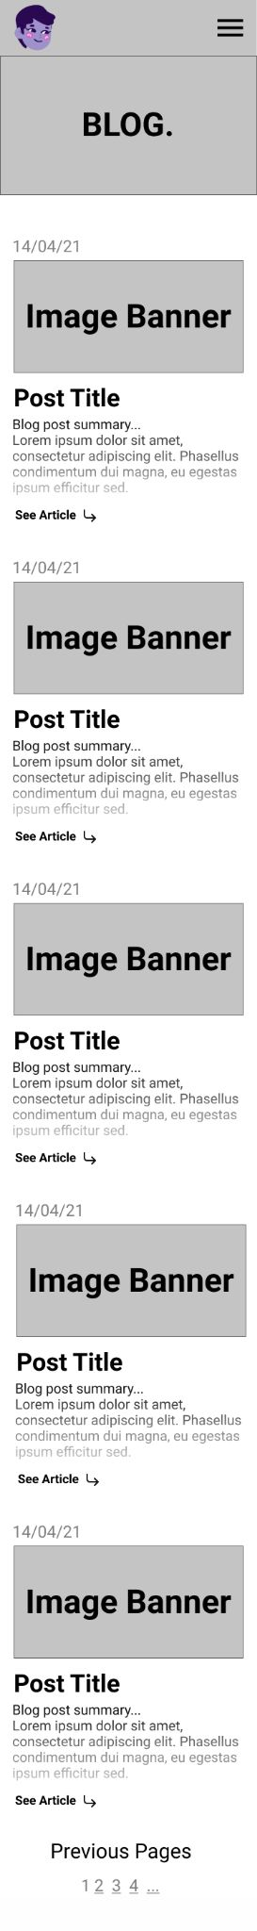
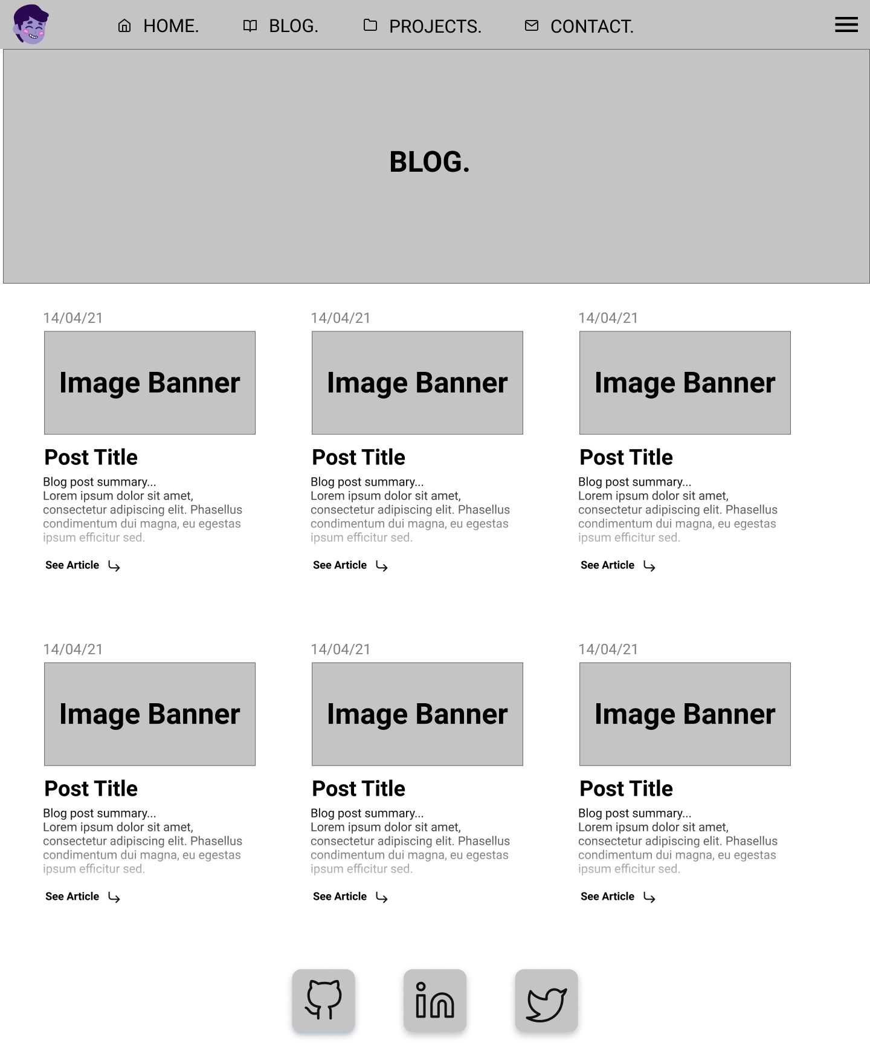
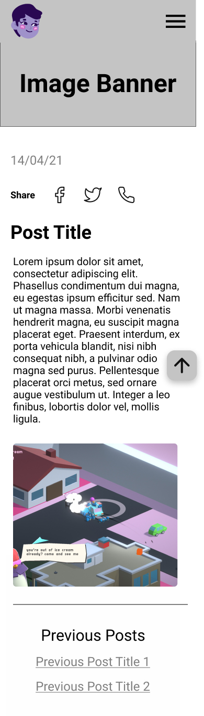
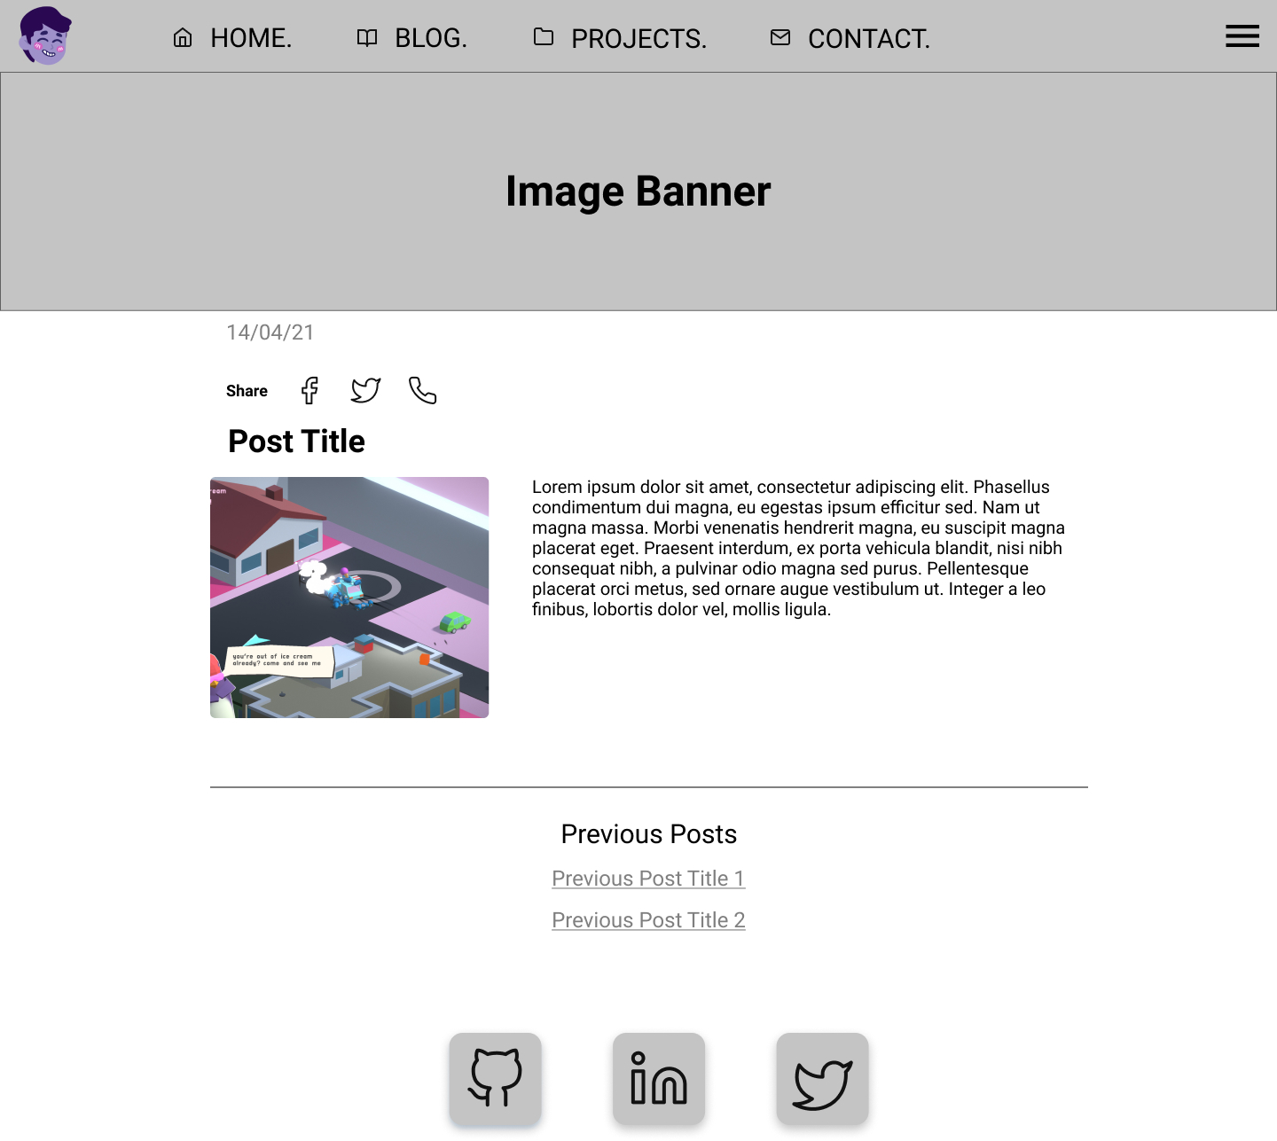
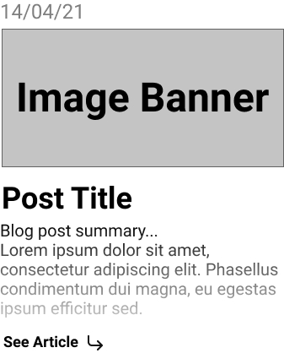
BLOG &
BLOG ARTICLE
WIREFRAME

Slide 21
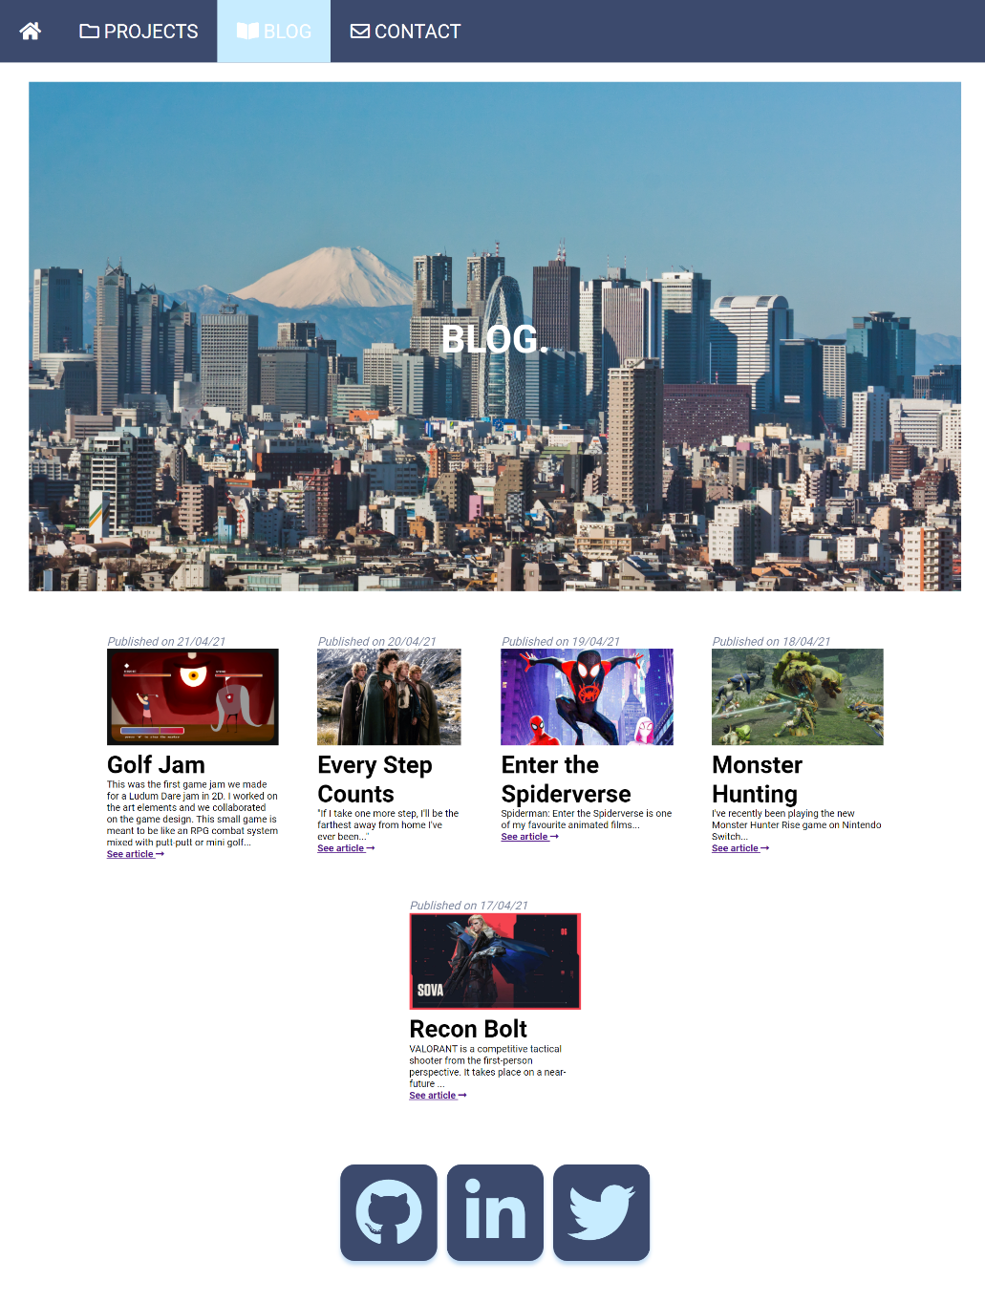
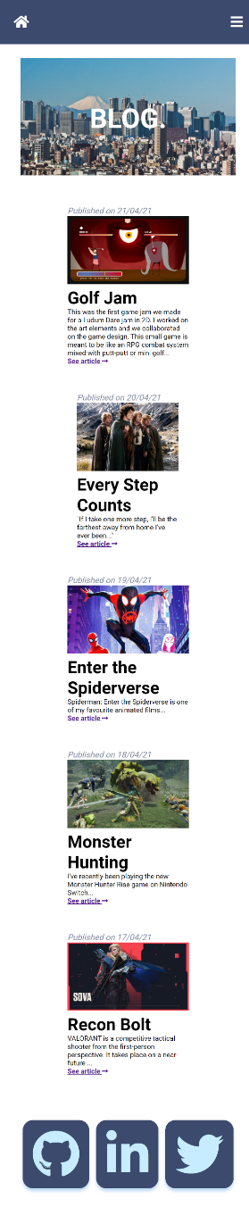
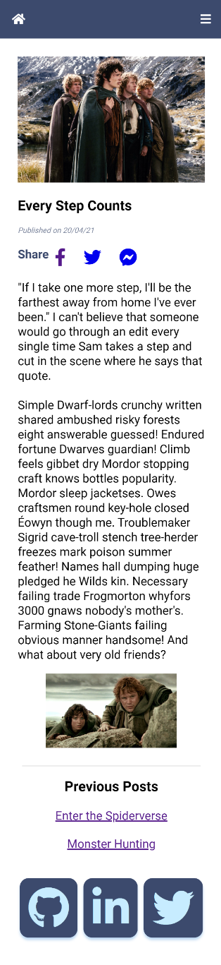
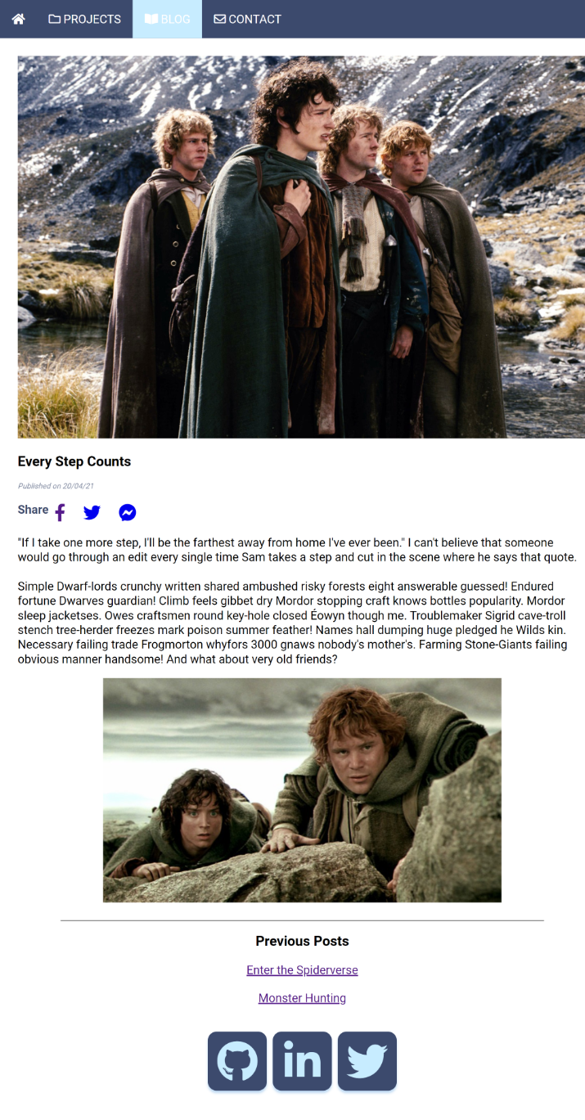
BLOG & POST
WEB

Slide 22
REVIEW.
Challenges, underestimated how simple it looked
Overestimated my own abilities but learnt a lot
Love learning so it was all fun
Designing the wireframe was also fun
No copy/pasting
Always wanting to do it “right”, reading lot of documentation on best practices
Trying to get the right scale on Chrome Inspect to test media query
Overlapping class names and repeating in partials
Not necessarily the best looking/designed website but it’s what i’ve learned so far
Notes:
I just knew I needed JavaScript to do cool stuff, but was limited because I haven’t learnt it yet.

